Slide 1
Modeling growth in stock assessments using Stock Synthesis
Ian Taylor
CAPAM Growth Workshop
2 November 2014

Slide 2
Outline
additional materials at https://github.com/taylori/SSgrowth

Slide 3
Parameterization of growth

Slide 4
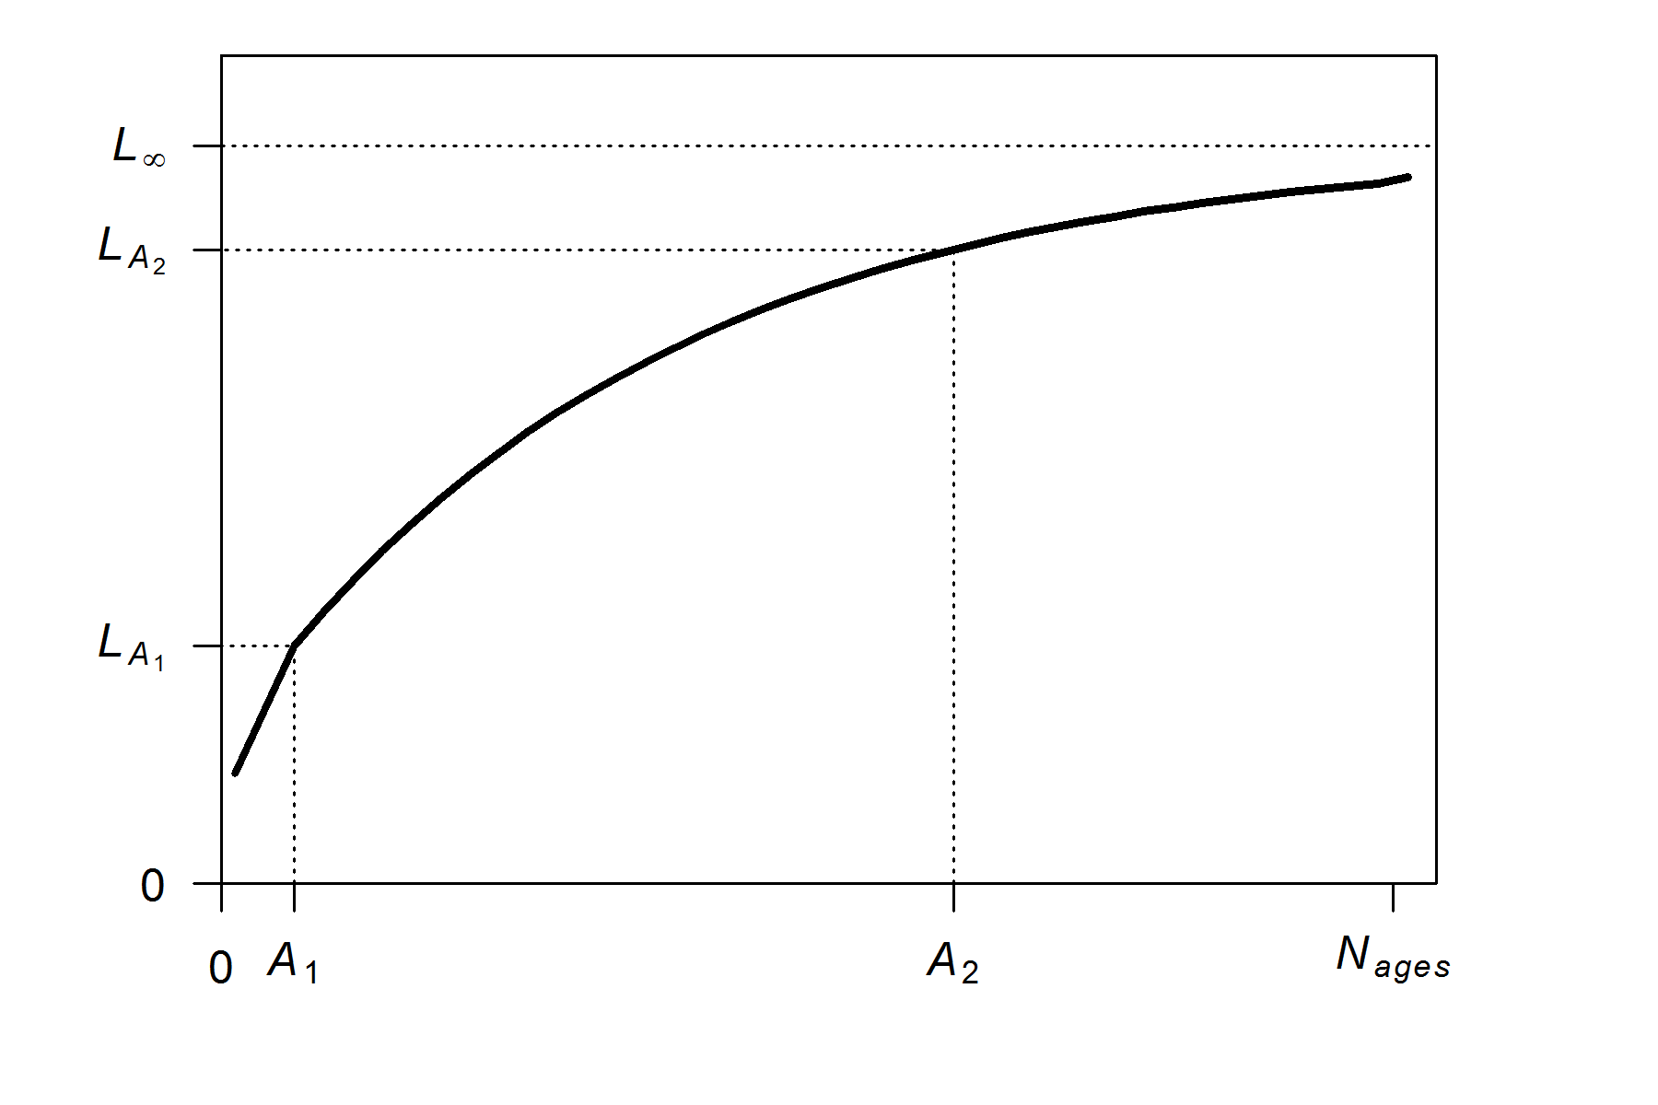
Parameterization of growth
Von Bertalanffy growth with 2 reference ages

Slide 5
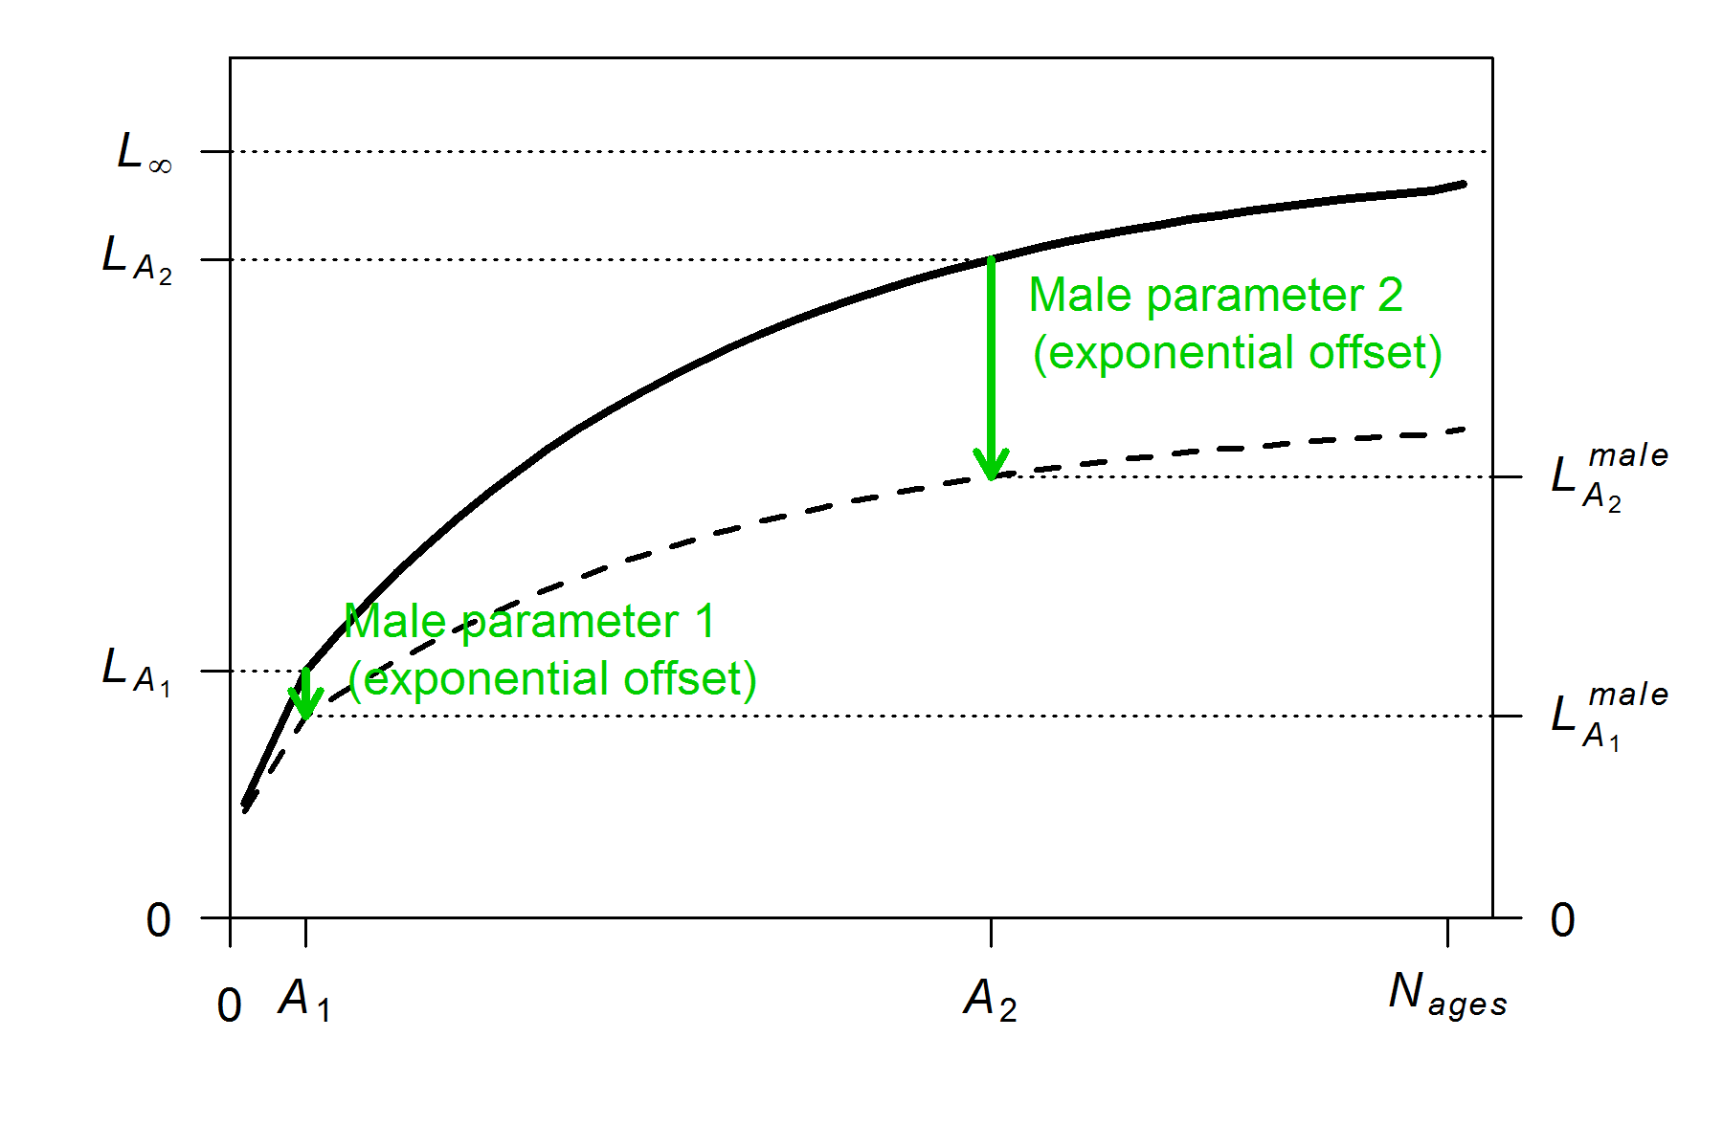
Parameterization of growth
Male growth can be separate parameters or exponential offsets

Slide 6
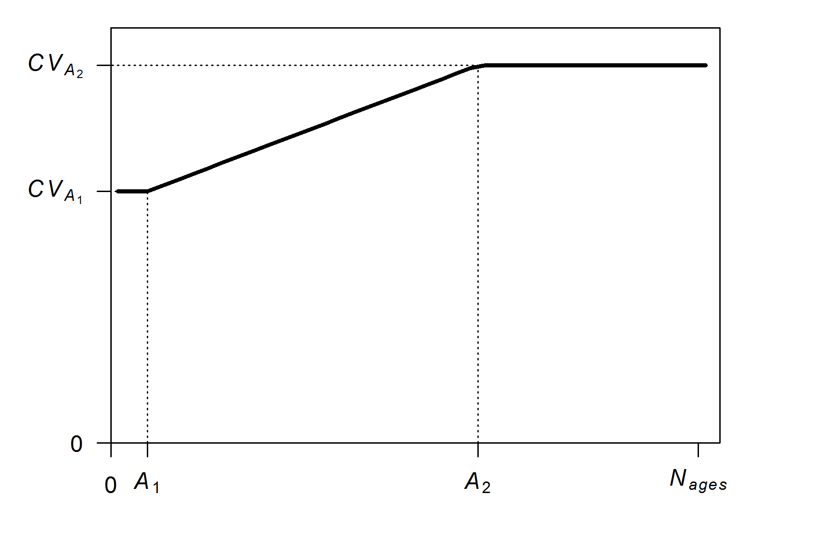
Parameterization of growth
Variability in length at age determined by 2-parameter “dogleg” function (with same reference ages as growth curve)

Slide 7
Parameterization of growth
Variability in length at age determined by 2-parameter “dogleg” function (with same reference ages as growth curve)

Slide 8
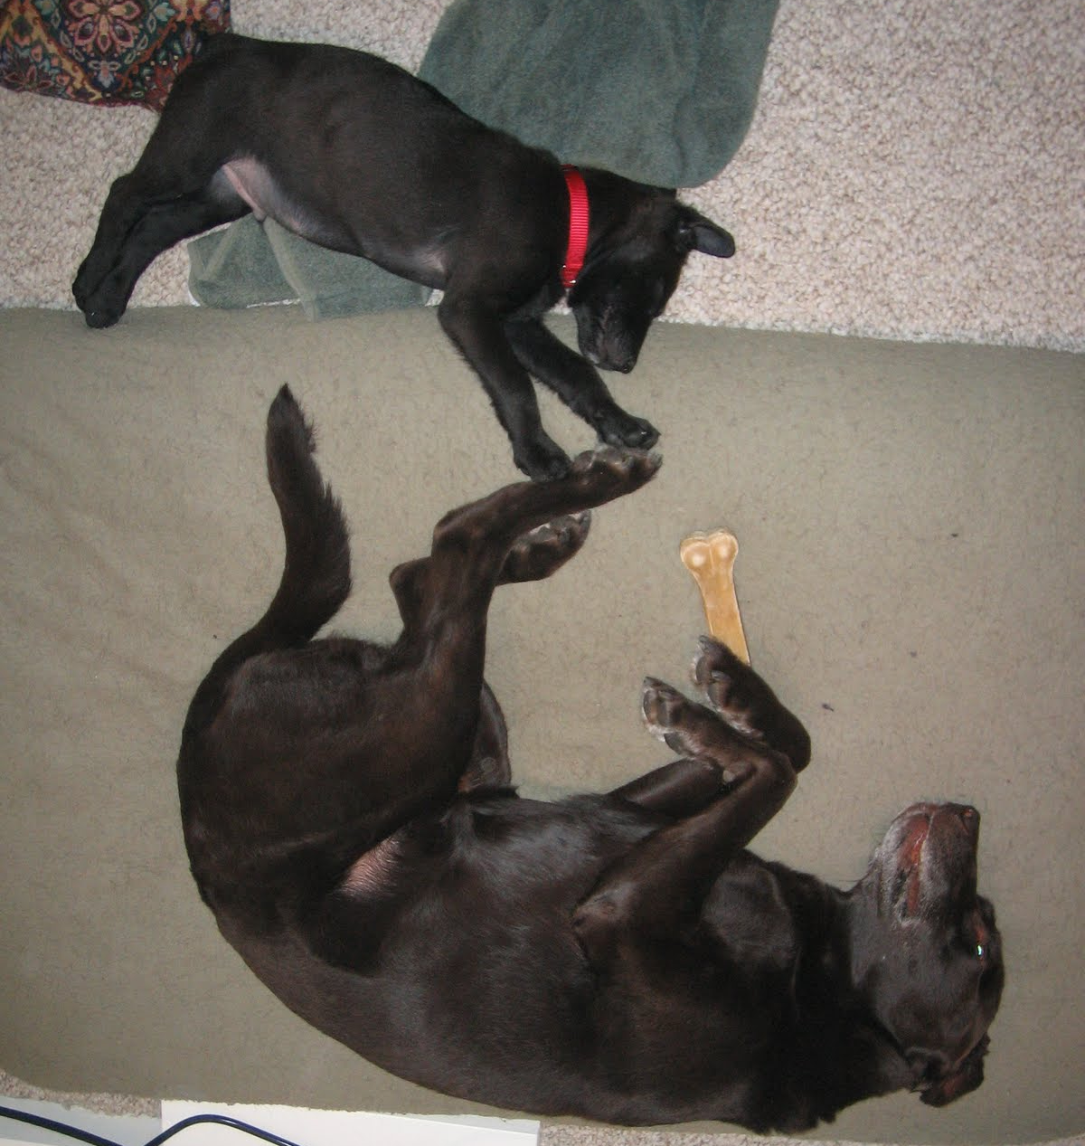
Parameterization of growth
Variability in length at age determined by 2-parameter “dogleg” function (with same reference ages as growth curve)

Slide 9
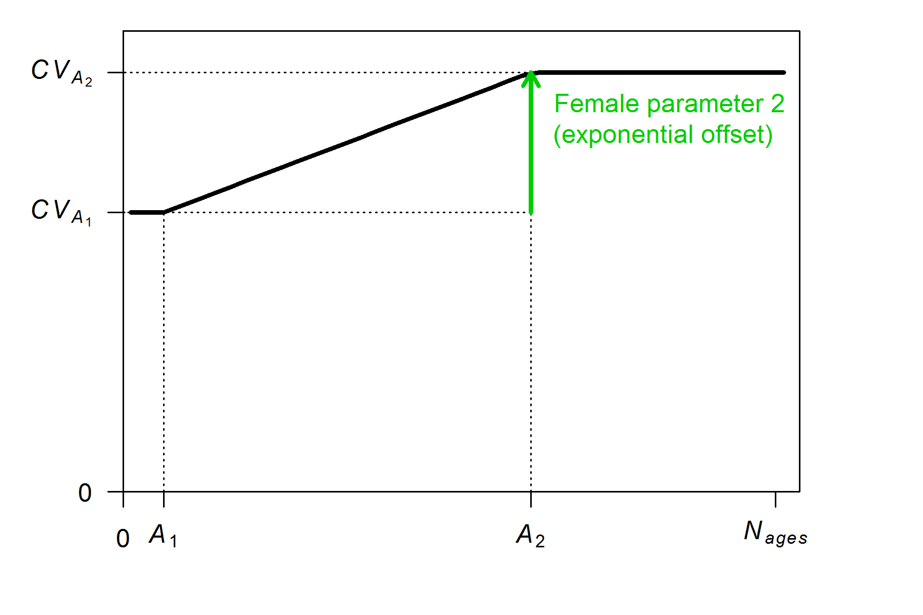
Parameterization of growth
Offset options for variability:
#_parameter_offset_approach (1=none, 2= M, G, CV_G as offset from female-GP1, 3=like SS2 V1.x)

Slide 10
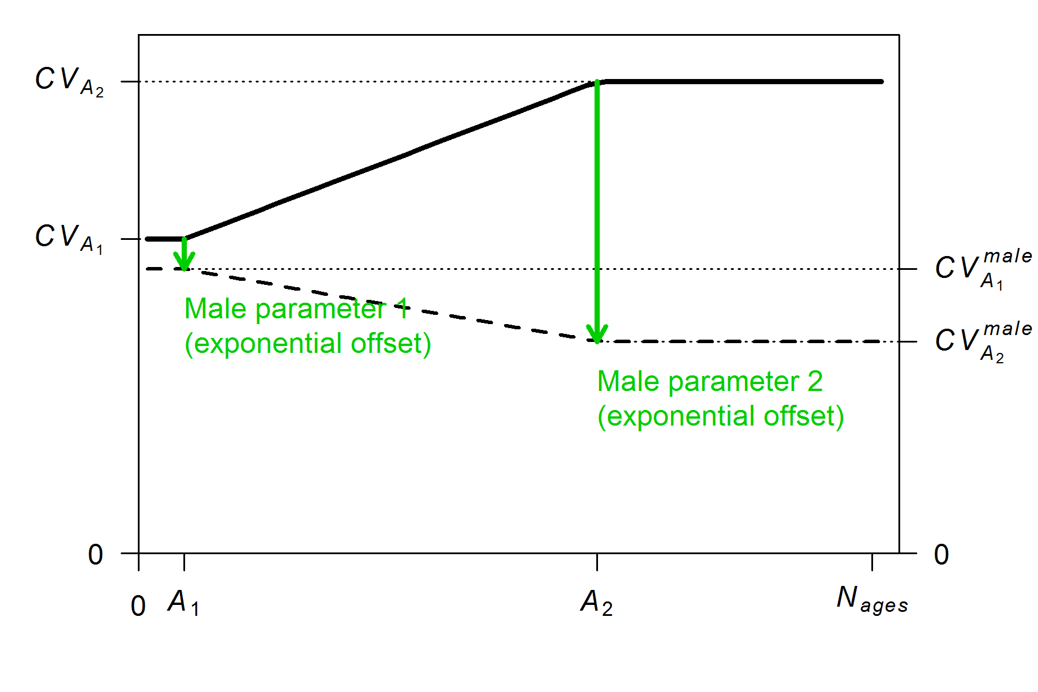
Parameterization of growth
Von Bertalanffy growth with 2 reference ages

Slide 11
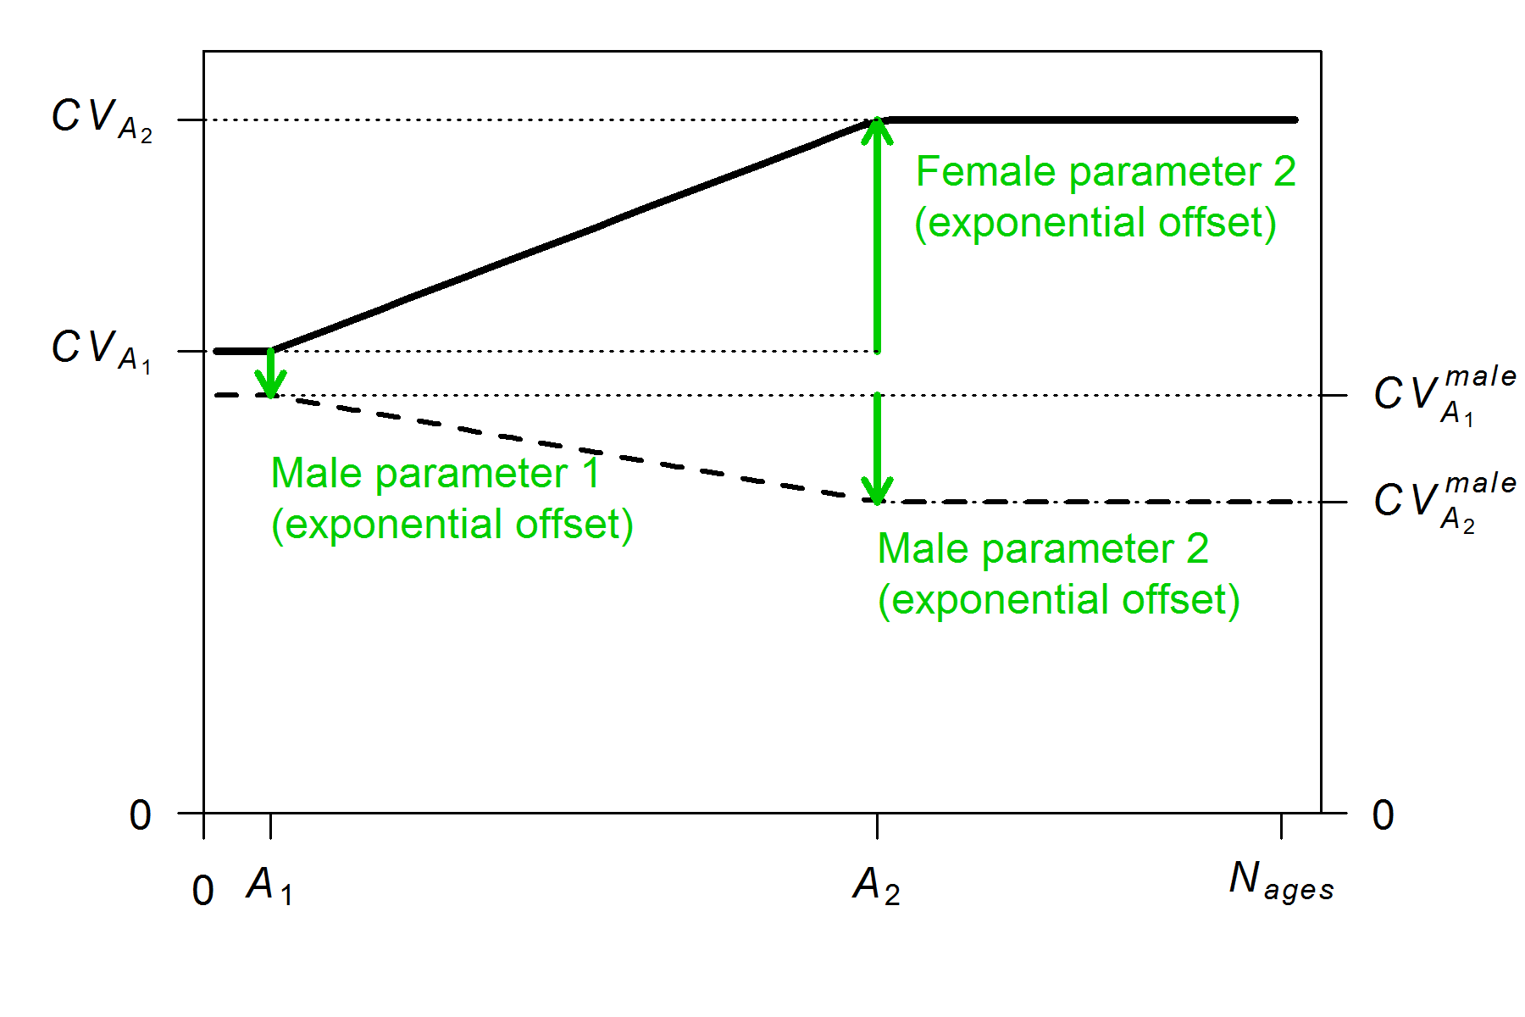
Parameterization of growth
Von Bertalanffy growth with 2 reference ages

Slide 12
Example models

